Slide 1
PREDICTING MESSAGE PROPAGATION

Slide 2
THE TEAM :
Mentor : Mrs.T.Rajasenbagam M.E , Assistant Professor , Department of CSE.
Members : Dharun A
Mohamed Asik S
Nivas G
Gopinath A
Mohan Raj N

Slide 3
ABSTRACT :
The aim of this project is to predict the influencers in a social network. Here, we can predict the influence rate for an individual person or comparative study of influence rate between the multiple users by using different learning models and auxiliary techniques.In our project , the goal is to predict the influencers in specific social forum such as Twitter for Political foray.

Slide 4
INPUT :
Collection of Raw Data using Twitter Application Programming Interface (API) which consist of text Analysis and 11 features such as ,
1) Followers, 7) retweets_sent,
2) Followings, 8) retweets_received,
3) Listed, 9) network_feature_1,
4) posts, 10) network_feature_2,
5) mentions_received, 11) network_feature_3.
6) mentions_sent,

Slide 5
EXISTING RELATED WORK :
Small World phenomenon :
Approach 1 : Existence of shortest path rate between unrelated people.
Approach 2 : Mean Degree of separation for twitter at 4.59 ( strong inter-linking )
USER GRAPH :
Approach 1 : Vertex Partitioning algorithms.
Approach 2 : Suggesting friends with implicit graphs
Retweet Prediction :
Approach 1 : Analysing Statuses gives accuracy of 76.2%.
Approach 2 : Unsupervised model & Supervised model with accuracy of 69.3% and 82.7% respectively.

Slide 6
Proposal System :
Message Propagation : Decision Tree classification
Network Algorithm : Deep Learning
1) Ego Networks – with turnaround time & retweet probability
2) J4.8 Classifier
3) Random Forest – with combination of decision trees
4) CNN with CV - Convolution Neural Network with Cross Validation.
Expected Accuracy rate : 87-95%

Slide 7
LITREATURE SURVEY

Slide 8
1) BASE PAPER : A Micromodel to Predict Message Propagation for Twitter Users
OBJECTIVE | The goal is to predict the influencers and message propagation in specific social forum such as Twitter.
TECHNIQUES | Decision Tree classification Ego Networks – with turnaround time & retweet probability J4.8 Classifier Random Forest – with combination of decision trees CNN with CV - Convolution Neural Network with Cross Validation.
EXPERIMENTAL RESULTS | J4.8 Classifier – 80.7% Random Forest – 82.7% CNN with CV - Convolution Neural Network with Cross Validation : Expected : 87-95%
ADVANTAGES | Well impact in Sociology , Governance , Economics Will learn the Cognitive properties which make human relations Helpful for Qualitative research to find valid users and to prevent spammers
DE-MERITS | Challenging to predict True Negatives

Slide 9
2) The effect of wording on message propagation: Topic- and author-controlled natural experiments on Twitter
OBJECTIVE | To investigate whether a different choice of words affects message propagation, controlling for user and topic.
TECHNIQUES | Crawling time-lines via Twitter API
EXPERIMENTAL RESULTS | Investigates computationally what wording features correspond to messages achieving a broader reach. Use hypothesis testing to evaluate the importance of each feature for message propagation. .
ADVANTAGES | Efficacy and author preference Predicting the “better” wording
DE-MERITS | Propagation prediction becomes more challenging when topic and author controls are applied.

Slide 10
3) The Small World Problem
OBJECTIVE | To determine the shortest paths of acquaintances required to reach each other.
TECHNIQUES | Harvard Approach (A mathematical approach)
EXPERIMENTAL RESULTS | Establishes the existence of a short path between unrelated people to deliver a message. Secondly, it showed people collaborating within their independent capabilities could deliver the message outside their immediate social circle.
ADVANTAGES | The empirically-created chains between persons chosen at random form a major population. Establishes a good deal about the integration of society.
DE-MERITS | The big obstacle one runs up against the problem is the social structure.

Slide 11
4) PTMIB: Profiling Top Most Influential Blogger using Content Based Data Mining Approach
OBJECTIVE | To determine the top most influential blogger at any instance of time
TECHNIQUES | Cosine Similarity Method Term Frequency and Inverse Document Frequency (TF-IDF) PTMIB Algorithm
EXPERIMENTAL RESULTS | The contents of the blog network documents are analyzed by using tf-idf and obtaining the cosine similarity score, during conflicts in determining the Influential Blogger.
ADVANTAGES | Eliminates the conflicts in determining similarity Helps in identifying criminal activities
DE-MERITS | Implementing PTMIB algorithm is difficult. But the usage of PTMIB alone eliminates the conflict

Slide 12
5 ) Mean Degrees of Separation
OBJECTIVE | To estimate the number of unique friends for each degree of separation
TECHNIQUES | Hash Bitwise OR 1/2^{n} - devising
EXPERIMENTAL RESULTS | In our implementation, at each step each person sends a hash value to all his friends. We do this recursively and use math to estimate the number of unique friends for each degree of separation.
ADVANTAGES | Six degrees of separation between user and everyone else on social forum
DE-MERITS | Computing multiple times will produce better results

Slide 13
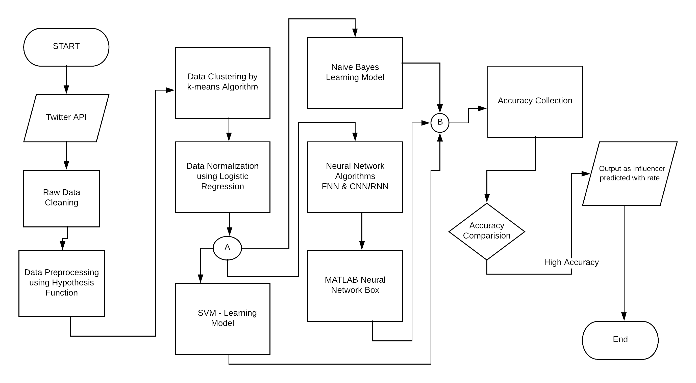
FLOWCHART :

Slide 14
OUTPUT :
Person/Persons with Influence Rate and their features by using visualization.

Slide 15
REFERENCES
C.Tan,L.lee,B.pang ,” The effect of wording on message propagation:Topic- and author-controlled natural experiments on Twitter”,ICDSE 2015.
2. J.Travers and S.Milligram , “The Small world, Psychology” Today, Vol no .1, Proceedings of the 32nd Annual ACM Symphosium,2010.
3. G.Vasanthakumar , R.Priyanka , K.V.Raj , S.Bhavani , B.A.Rani , P.D Shenoy , and . K.Venugopal , “PTMIB : Profiling top most influential blogger using content based data mining approach “ , in International Conference on Data Science and Engineering ( ICDSE ) , IEEE 2016.
4. S.Bhagat,M.Burke,C.Diuk,I.O.Filiz, and S.Ednov(2016) Three and half degree of separation [online link] : https://research.fb.com/three-and-half-degrees-of-separation/

Slide 16
THANK YOU

